Slide 1
Sequential Circuit Design

Slide 2
State Optimization (Minimization)
Equivalent States:
  Two states are equivalent if, for each member of the set of inputs,
    they give exactly the same output and
    send the circuit either to the same state or to an equivalent state.
  If two states are equivalent, one can be eliminated without affecting the behavior of the FSM.

Slide 3
State Optimization Algorithm:
Row Matching
  Two states are equivalent if any of the conditions are true:
    If two states have the same output AND both transitions are to the same next state,
    If two states have the same output AND both transitions are to each other
    If two states have the same output AND both self-loop,
  Combine the equivalent states into a new renamed state.
  Repeat until no more states can be combined.

Slide 4
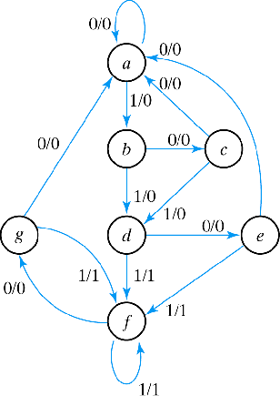
Row Matching by Example
State Transition Table
NS output
PS x=0 x=1 x=0 x=1
a a b 0 0
b c d 0 0
c a d 0 0
d e f 0 1
e a f 0 1
f g f 0 1
g a f 0 1

Slide 5
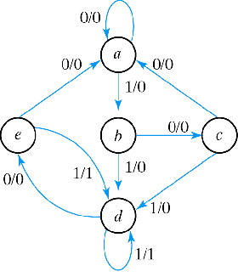
Row Matching Example (cont)
NS output
PS x=0 x=1 x=0 x=1
a a b 0 0
b c d 0 0
c a d 0 0
d e f 0 1
e a f 0 1
f e f 0 1
Reduced State Transition Diagram
NS output
PS x=0 x=1 x=0 x=1
a a b 0 0
b c d 0 0
c a d 0 0
d e d 0 1
e a d 0 1

Slide 6
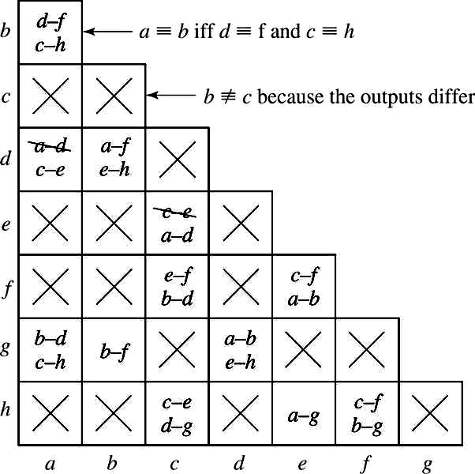
State Optimization Algorithm
Implication Chart
Present State | Next State |  | Output
 | X=0 | 1 | X=0
a | d | c | 0
b | f | h | 0
c | e | d | 1
d | a | e | 0
e | c | a | 1
f | f | b | 1
g | b | h | 0
h | c | g | 1

Slide 7
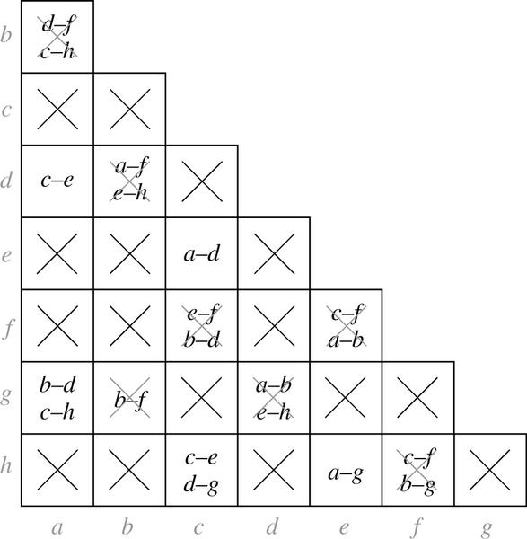
State Optimization Algorithm
Implication Chart After First Pass
  Processing order is important

Slide 8
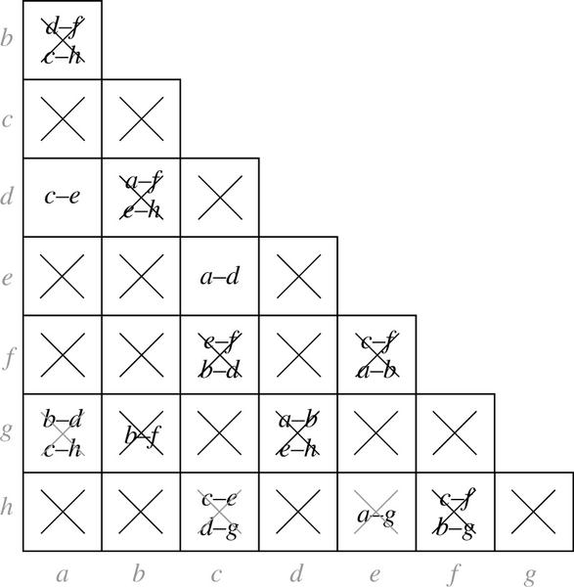
State Optimization Algorithm
Implication Chart After Second Pass
Present State | Next State |  | Present Output
 | X=0 | 1 | X=0
a | d | c | 0
b | f | h | 0
c | e | d | 1
d | a | e | 0
e | c | a | 1
f | f | b | 1
g | b | h | 0
h | c | g | 1
Present State | Next State |  | Output
 | X=0 | 1
a | a | c | 0
b | f | h | 0
c | c | a | 1
f | f | b | 1
g | b | h | 0
h | c | g | 1

Slide 9
Equivalent Sequential Circuits
Definition:
  Sequential circuit N1 is equivalent to sequential circuit N2 if
    for each state p in N1, there is a state q in N2 such that p≡q, and
    conversely, for each state s in N2, there is a state t in N1 such that s≡t.

Slide 10

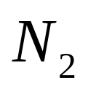
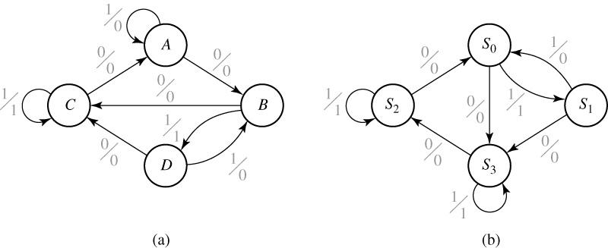
Example
 | X=0 | X=1 | X=0 | X=1
A | B | A | 0 | 0
B | C | D | 0 | 1
C | A | C | 0 | 1
D | C | B | 0 | 0
 | X=0 | X=1 | X=0 | X=1
S₀ | S₃ | S₁ | 0 | 1
S₁ | S₃ | S₀ | 0 | 0
S₂ | S₀ | S₂ | 0 | 0
S₃ | S₂ | S₃ | 0 | 1

Slide 11
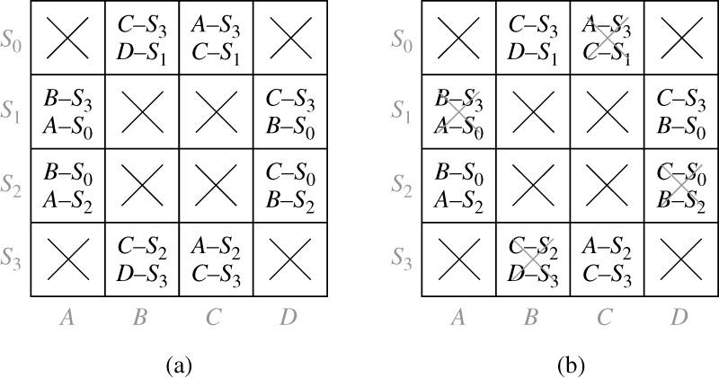
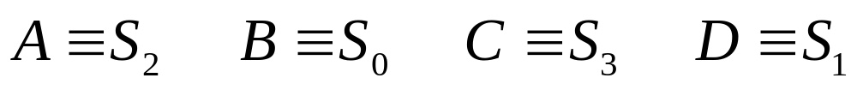
 | X=0 | X=1 | X=0 | X=1
A | B | A | 0 | 0
B | C | D | 0 | 1
C | A | C | 0 | 1
D | C | B | 0 | 0
 | X=0 | X=1 | X=0 | X=1
S₀ | S₃ | S₁ | 0 | 1
S₁ | S₃ | S₀ | 0 | 0
S₂ | S₀ | S₂ | 0 | 0
S₃ | S₂ | S₃ | 0 | 1
Implication Tables:

Slide 12
State Encoding or Assignment
  The simplest assignment of s coded states to 2^{n} possible states is to use the first s binary integers in binary counting order.
    000, 001, 010, 011, 100
  However, the simplest state assignment does not always lead to the simplest circuit.
    In fact, the state assignment often has a major effect on circuit cost (as previously shown).
  In general, the only formal way to find the best assignment is to try all the assignments.
    That’s too much work!!
  Have to use some general guidelines (using the next example) …

Slide 13
Example
  Design a clocked synchronous state machine with two inputs, A and B, and a single output Z that is 1 if:
    – A had the same value at each of the two previous clock ticks, or
    – B has been 1 since the last time that the first condition was true.
    – Otherwise, the output should be 0.
A
Z
B

Slide 14
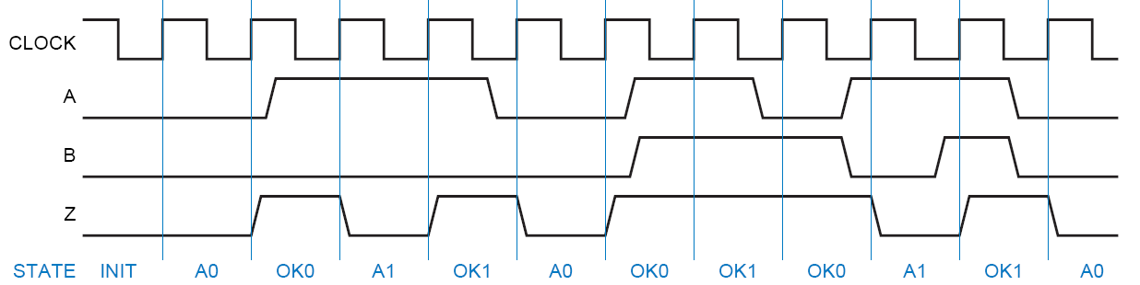
Timing Diagram

Slide 15
Moore Machine
A0: got 0 on A
OKA0: still OK (because from an OK state, got B=1), and got a 0 on A
A1: got 1 on A
Reset/0
OKA1: still OK (because from an OK state, got B=1), and got a 1 on A
OK00: got 00 on A
init
OK11: got 11 on A
10
00
11
01
00/01
10
A1
A0
00
11
10
01
10
11
00
10
00
11
00
01
10
OK11
OK00
01
11
10
00
11
01
11
OKA1
OKA0
01

Slide 16
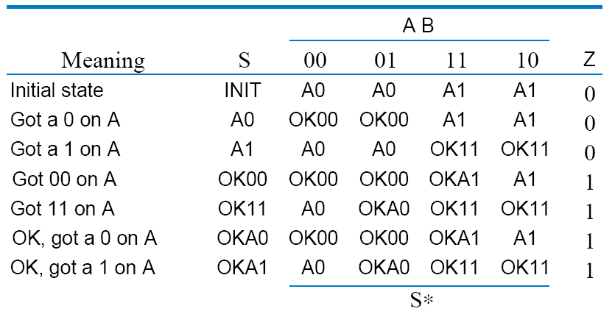
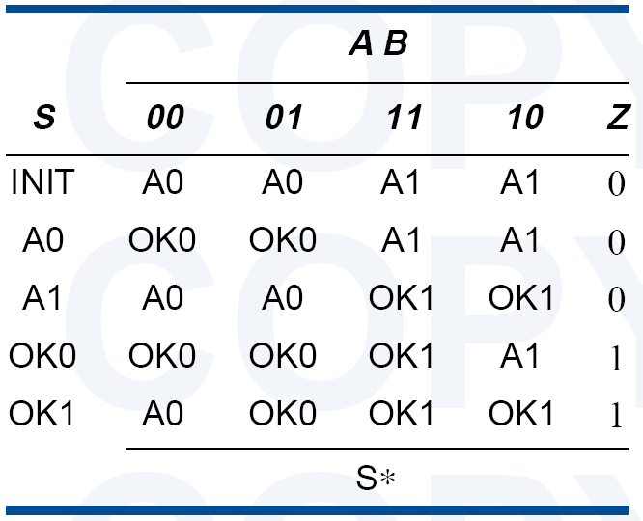
State Table
  OK00 and OKA0 are equivalent
  OK11 and OKA1 are equivalent

Slide 17
Moore Machine
A0: got 0 on A
OKA0: still OK (because from an OK state, got B=1), and got a 0 on A
A1: got 1 on A
Reset/0
OKA1: still OK (because from an OK state, got B=1), and got a 1 on A
OK00: got 00 on A
init
OK11: got 11 on A
10
00
11
01
00/01
10
A1
A0
00
11
10
01
11
10
00
11
00
01
10
OK1
OK0
11
01

Slide 18
State Encoding
Guidelines:
  Choose an initial coded state into which the machine can easily be forced at reset
    00. . . 00 or 11. . . 11 in typical circuits.
  Minimize the number of state variables that change on each transition.
  Maximize the number of state variables that don’t change in a group of related states
    i.e., a group of states in which most of transitions stay within the group.

Slide 19
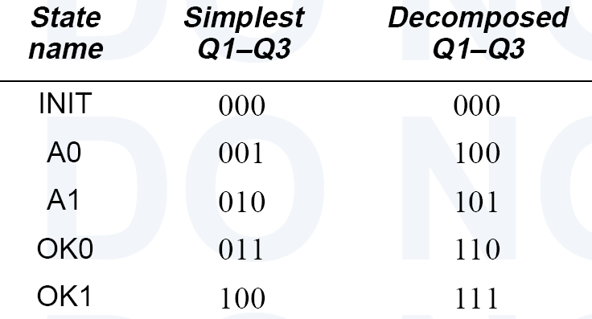
State Encoding
Example:

Slide 20
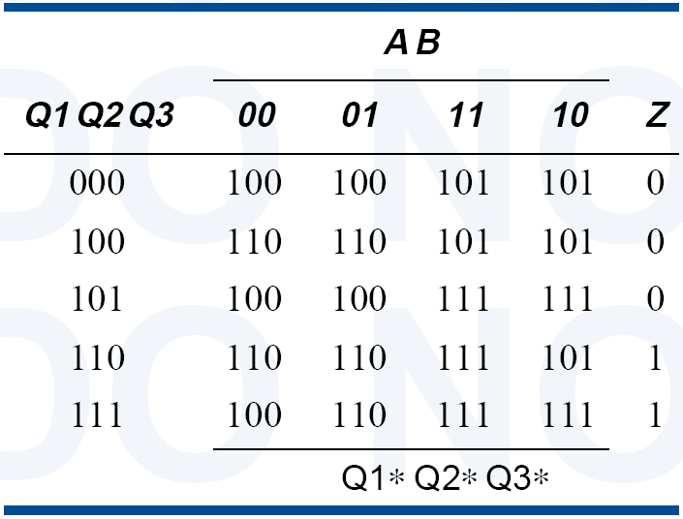
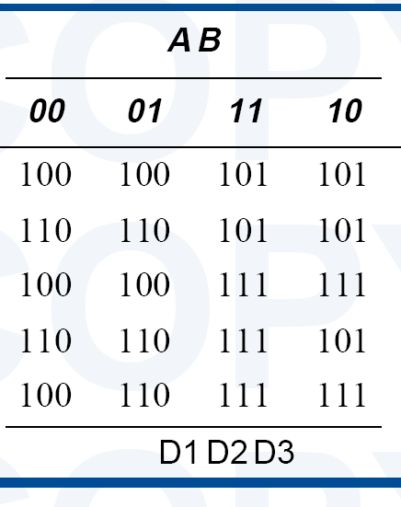
Synthesis Using D FF
Present State
Next State
Output

Slide 21
State Assignment
Unused States:
  Each of the m states must be assigned a unique code
  Minimum number of bits required is n such that
  n ≥ log2 m
  where x is the smallest integer ≥ x
  There may be 2^{n} - m unused states

Slide 22
State Assignment
Unused States:
  Minimal risk:
    Assumes that it is possible for the state machine to somehow get into one of the unused (or “illegal”) states,
      (due to a hardware failure, an unexpected input).
    Therefore, all unused states go to the “initial” state
  Minimal cost:
    Assumes that the machine will never enter an unused state.
    Therefore, the next-state entries of the unused states are marked as “don’t-cares”.

Slide 23
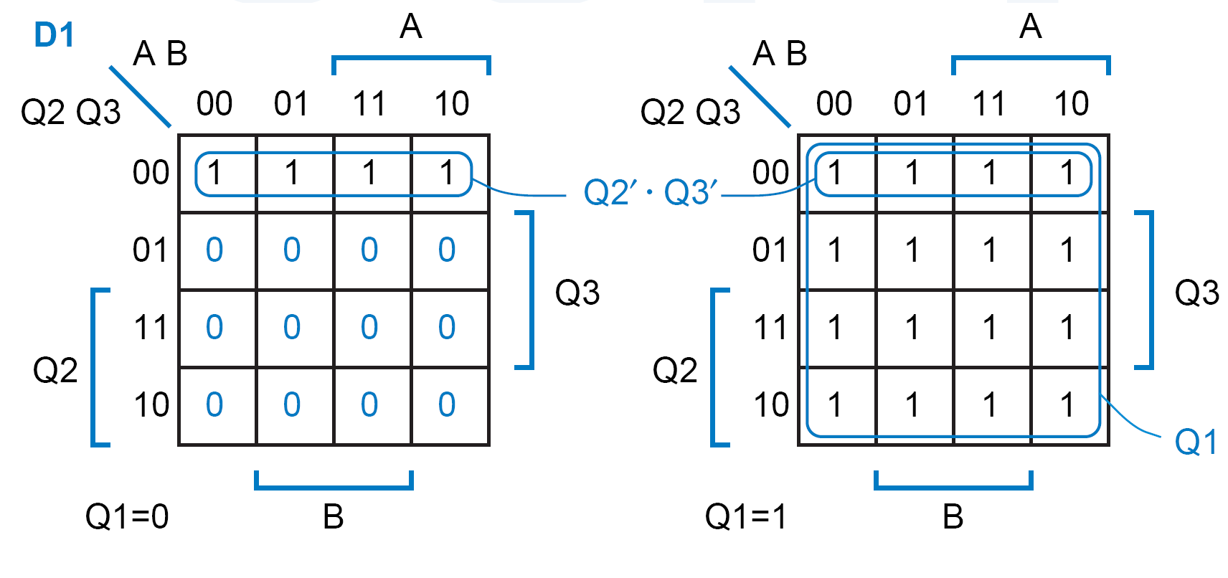
Case 1: Minimal Risk
Assumption:
  Unused states go to 000 (minimal risk)
D1 = Q1 + Q2′.Q3′

Slide 24
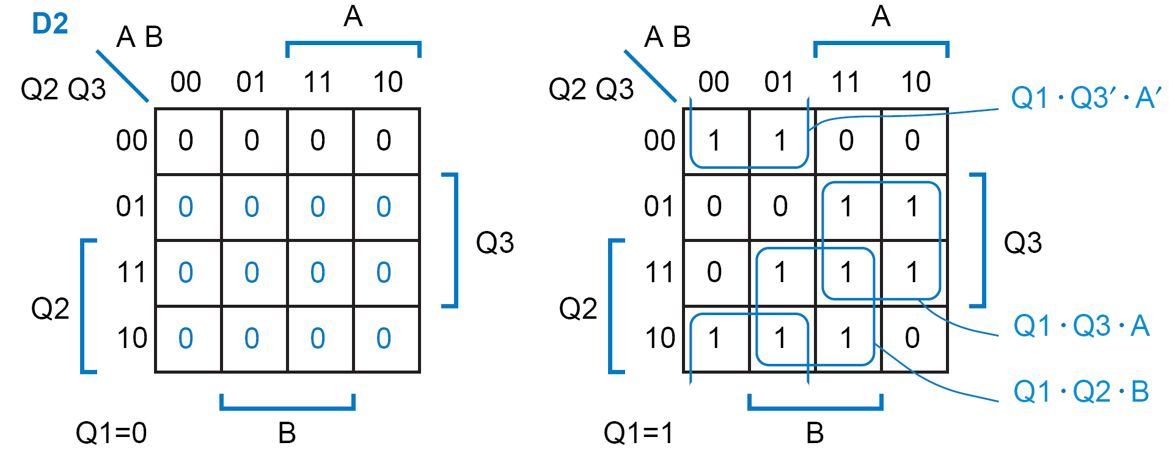
Case 1: D2 Equation
D2 = Q1.Q3′.A′ + Q1.Q3.A + Q1.Q2.B

Slide 25
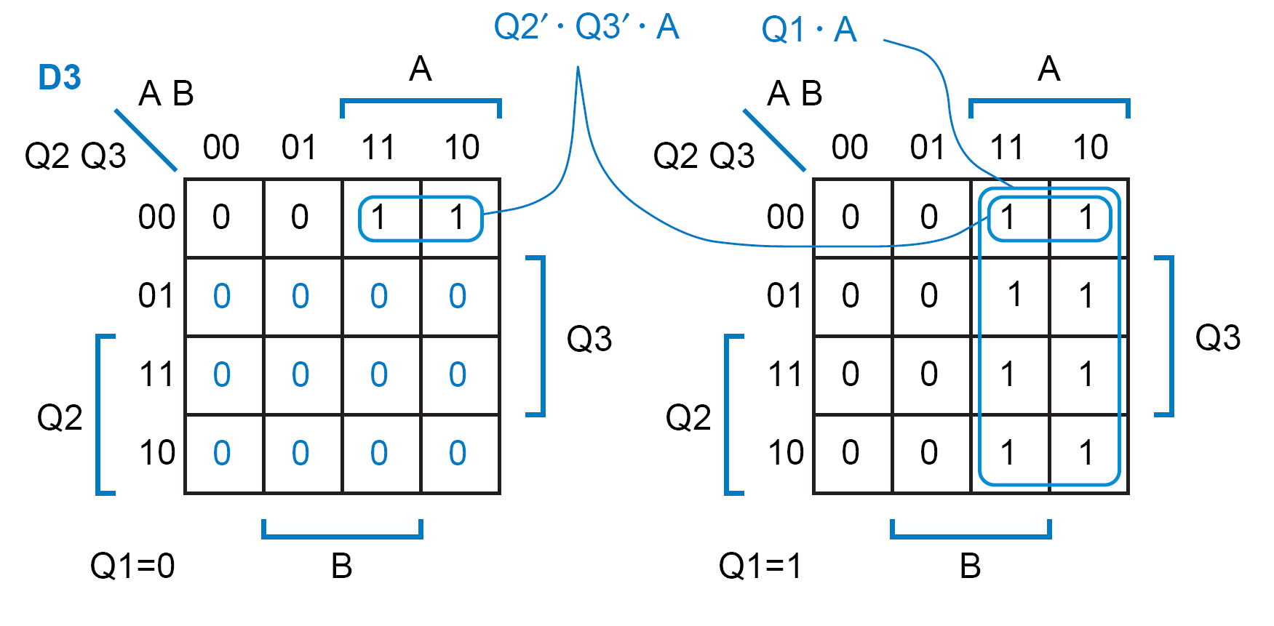
Case 1: D3 Equation
D3 = Q1.A + Q2′.Q3′.A

Slide 26
Case 1: Z Equation
Z = Q1.Q2.Q3′ + Q1.Q2.Q3
= Q1.Q2

Slide 27
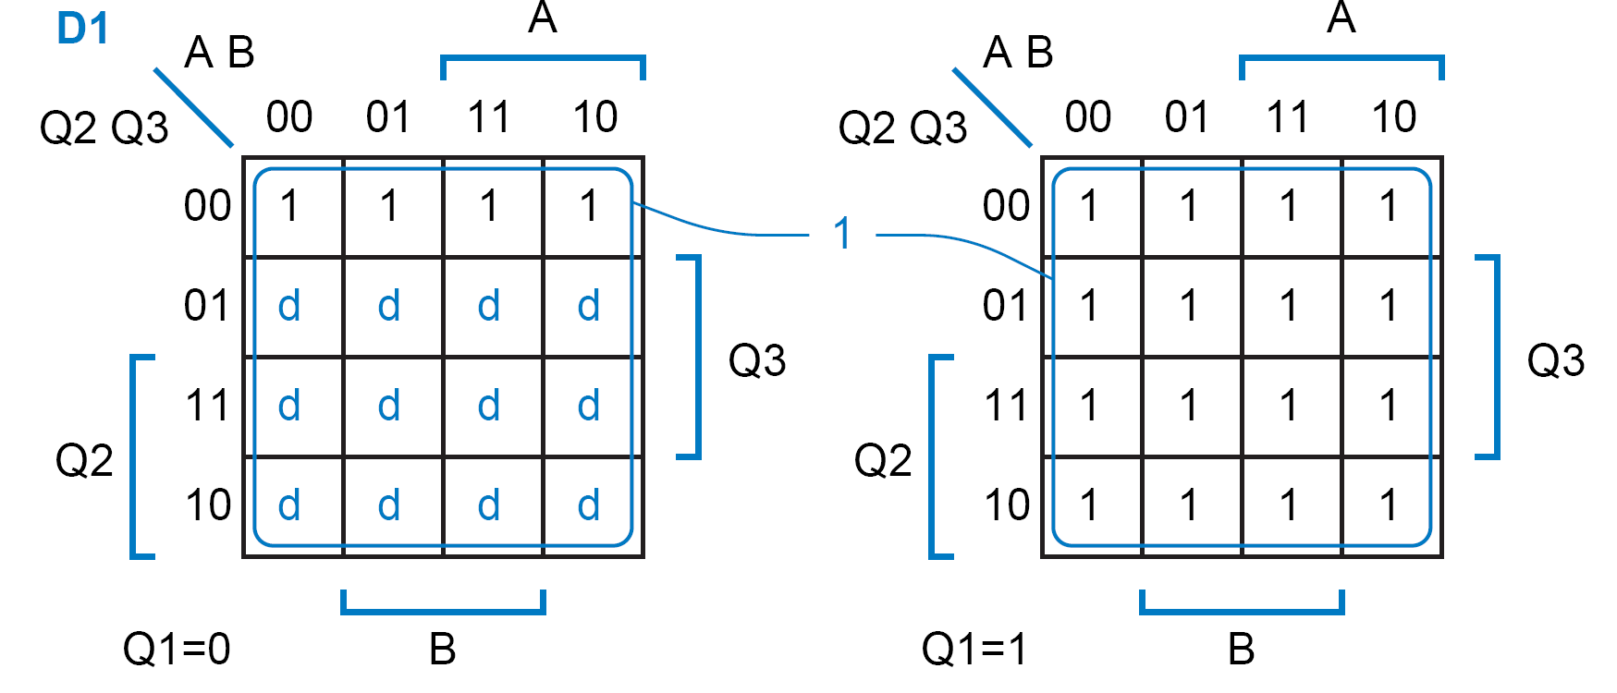
Case 2: Minimal Cost
Assumption:
  Next states of unused states are “don’t-cares” (minimal cost)
  → Z = don’t care for unused states
D1 = 1

Slide 28
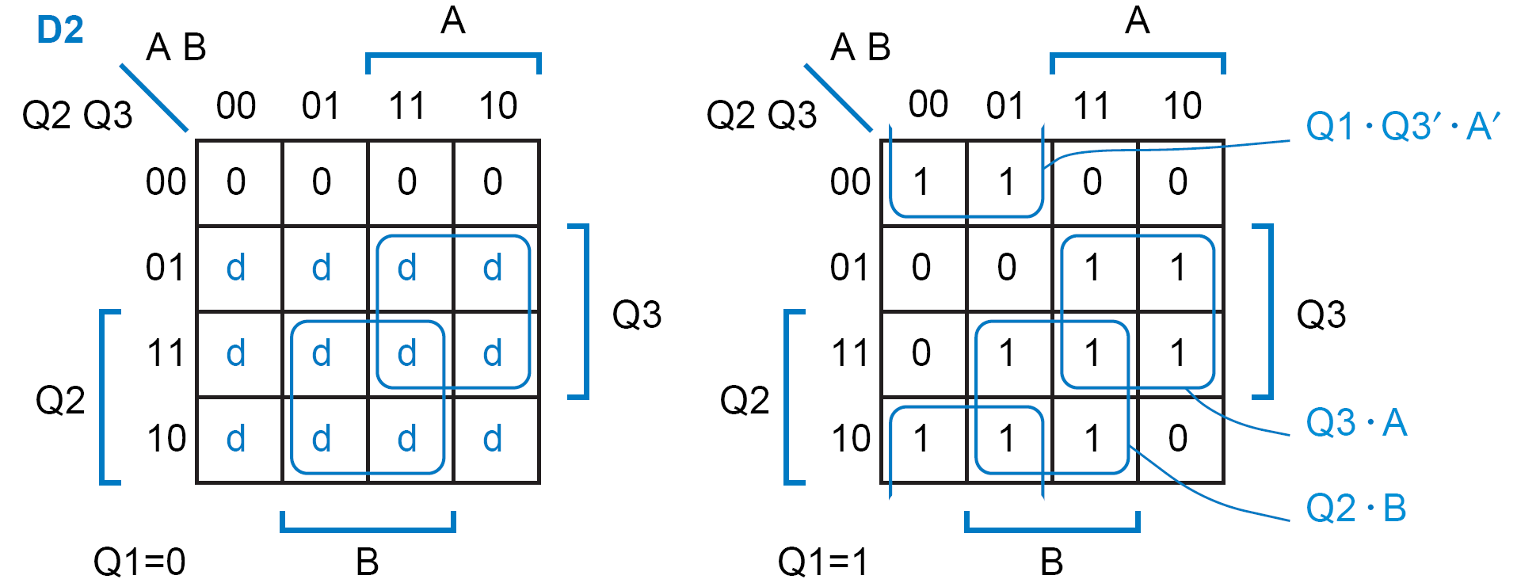
Case 2: D2 Equation
D2 = Q1.Q3′.A′ + Q3.A + Q2.B

Slide 29
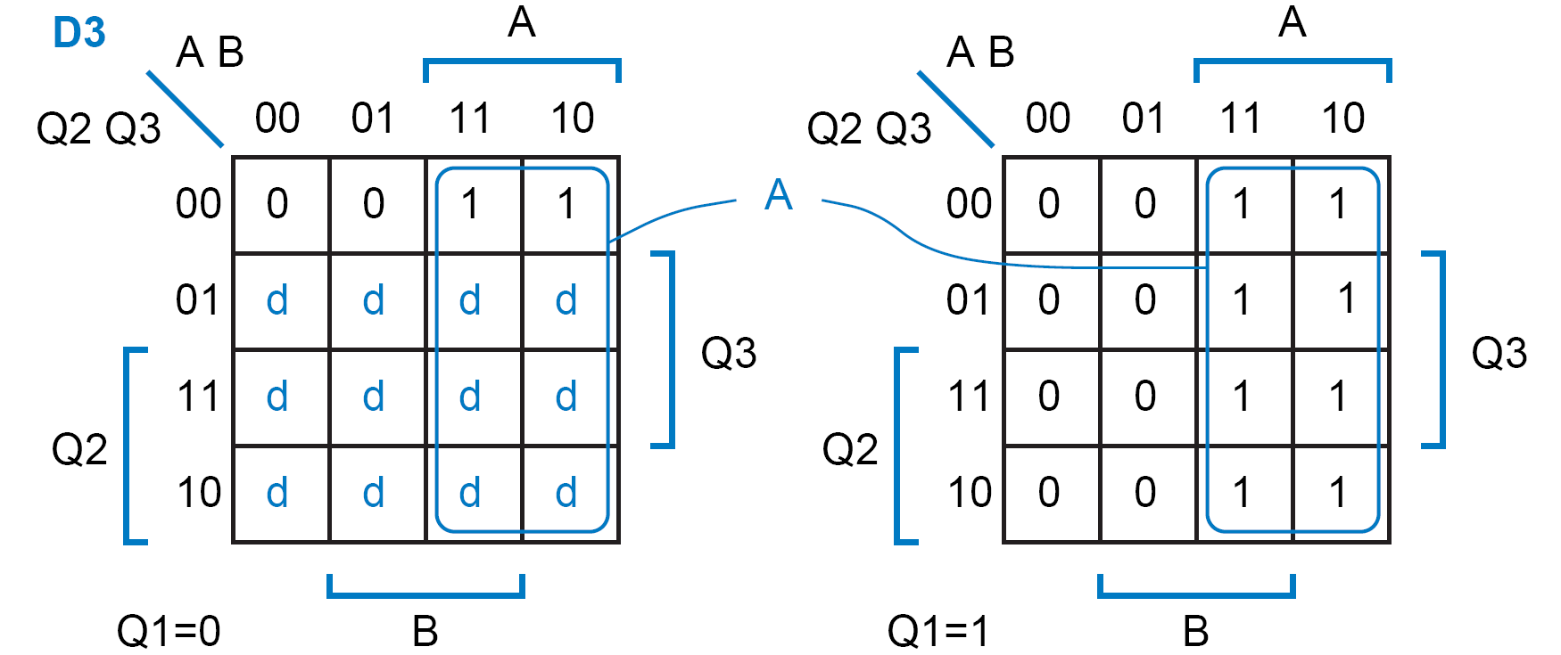
Case 2: D3 Equation
D3 = A

Slide 30
Case 2: Z Equation
Z = Q2

Slide 31
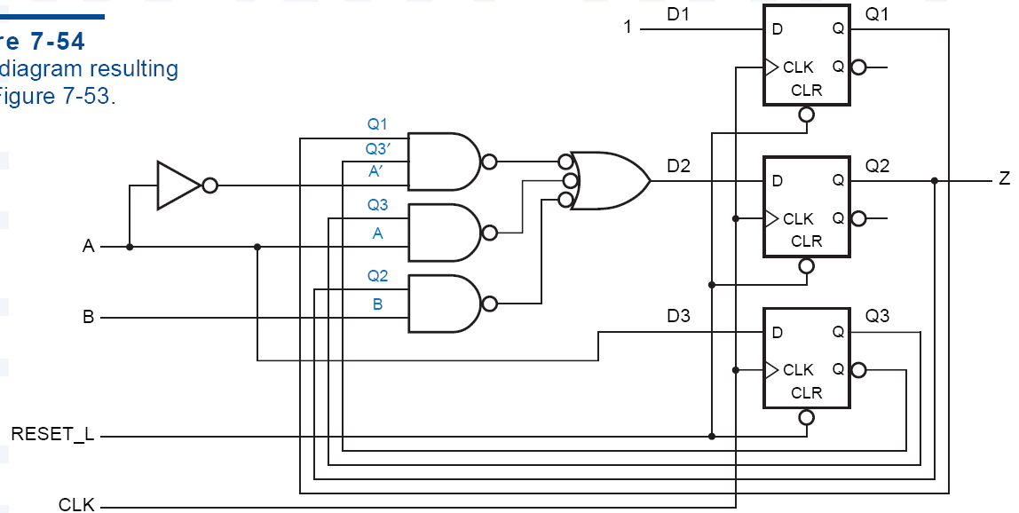
Case 2: Logic Diagram

Slide 32
State Assignment Comparison
Logic used:
  Minimal risk:
    25 input-gates (excluding inverters)
  Minimal cost:
    10 input-gates (excluding inverters)

Slide 33
Case 3: Synthesis Using JK FF
Characteristic Table:
J
K
Q(t+1)
Operation
0
0
Q(t)
No change
0
1
0
Reset
1
0
1
Set
1
1
Q(t)
Complement
Excitation Table:
Q(t)
Q(t+1)
J
K
Operation
0
0
0
X
No change
0
1
1
X
Set
1
0
X
1
Reset
1
1
X
0
No Change

Slide 34
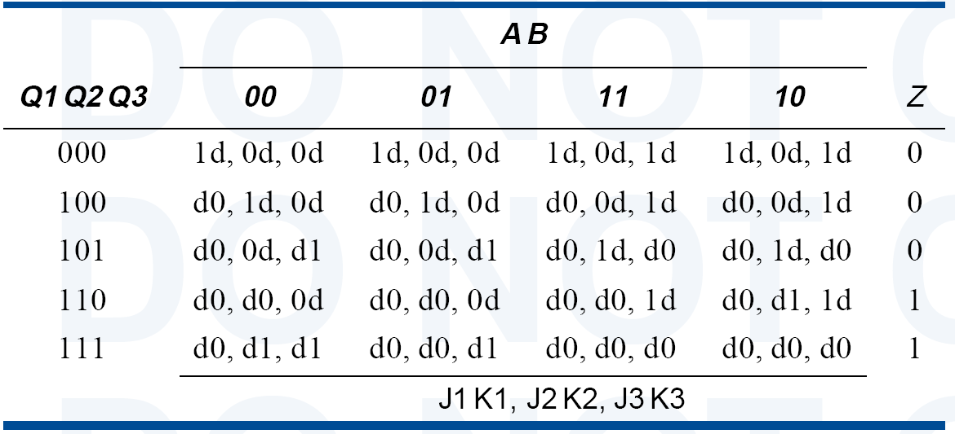

Slide 35
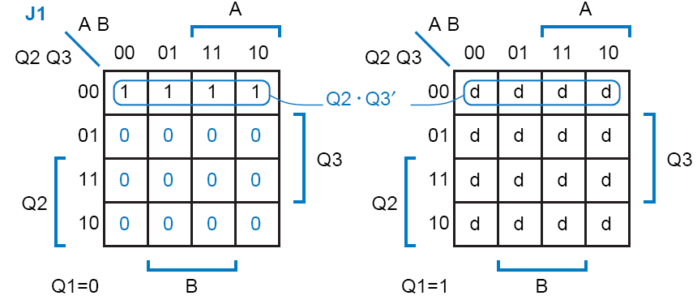
Case 3: Synthesis Using JK FF
  Needs separate logic for J and K.
J1 = Q2′.Q3′

Slide 36
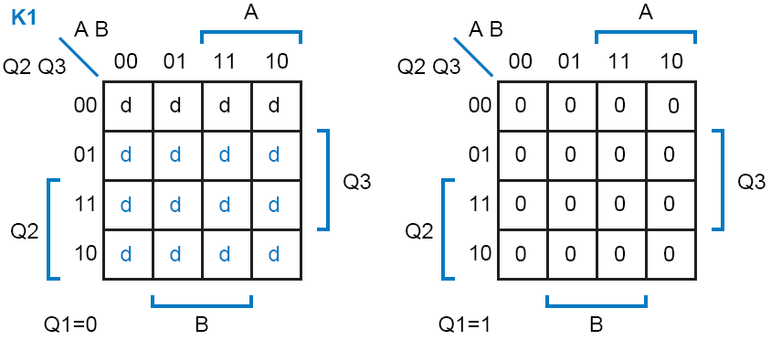
Case 3: Synthesis Using JK FF
K1 = 0

Slide 37
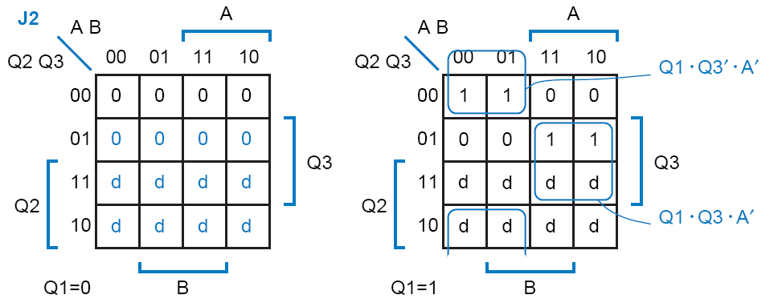
Case 3: Synthesis Using JK FF
J2 = Q1.Q3′.A′ + Q1.Q3.A

Slide 38
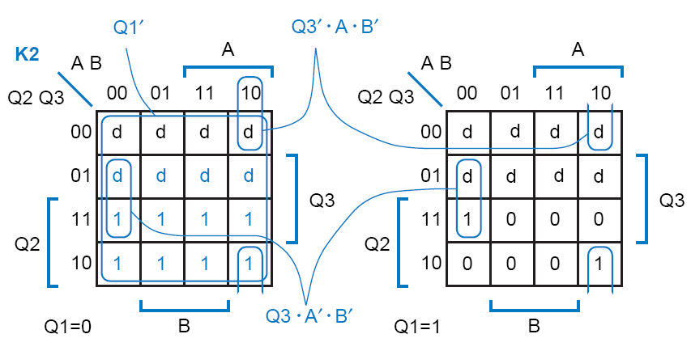
Case 3: Synthesis Using JK FF
K2 = Q1′ + Q3′.A.B′ + Q3.A′.B′

Slide 39
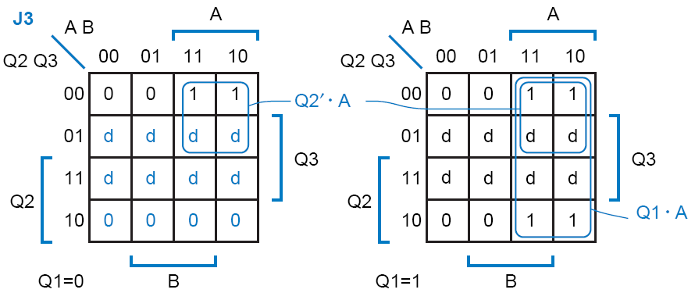
Case 3: Synthesis Using JK FF
J3 = Q2′.A + Q1.A

Slide 40
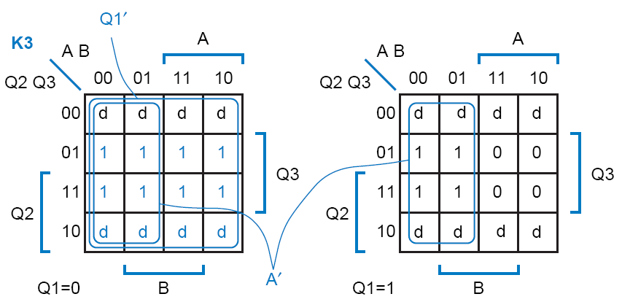
Case 3: Synthesis Using JK FF
K3 = Q1′ + A′

Slide 41
Case 3: Synthesis Using JK FF
  These equations take two more gates to realize than minimal-risk equations using D flip-flops
    so J-K flip-flops didn’t save us anything

Slide 42
Case 3: Synthesis Using JK FF
  Minimal cost using JK FF
J1 =1,
K1 = 0
J2 = Q1.Q3′.A′ + Q3.A
K2 = Q3′.A.B′ + Q3.A′.B′
J3 =A
K3 = A′

Slide 43
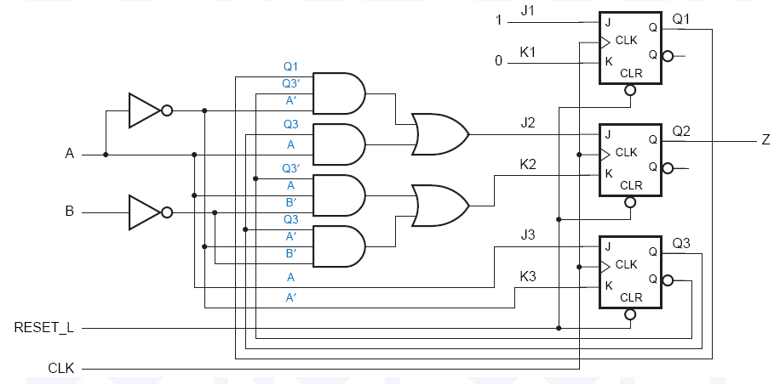
Case 3: Synthesis Using JK FF
  This circuit has two more gates than the minimal-cost D circuit
    J-K flip-flops still didn’t save us anything.

Slide 44
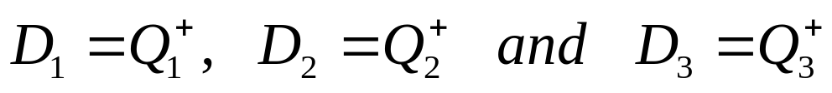
Sequential Circuit Design Using ROM or PLA
 |  |  |  |  |  | Z
 | Q₁ | Q₂ | Q₃ | X=0 | X=1 | X=0 | X=1
A B C D E H K | 0 0 0 0 1 1 1 | 0 0 1 1 0 0 1 | 0 1 0 1 0 1 0 | 001 011 100 101 101 000 000 | 010 100 100 101 110 000 - | 1 1 0 0 1 0 1 | 0 0 1 1 0 1 -

Slide 45
Sequential Circuit Design Using ROM or PLA
X | Q₁ | Q₂ | Q₃ | Z | D₁ | D₂ | D₃
0 0 0 0 0 0 0 0 1 1 1 1 1 1 1 1 | 0 0 0 0 1 1 1 1 0 0 0 0 1 1 1 1 | 0 0 1 1 0 0 1 1 0 0 1 1 0 0 1 1 | 0 1 0 1 0 1 0 1 0 1 0 1 0 1 0 1 | 1 1 0 0 1 0 1 x 0 0 1 1 0 1 x x | 0 0 1 1 1 0 0 x 0 1 1 1 1 0 x x | 0 1 0 0 0 0 0 x 1 0 0 0 1 0 x x | 1 1 0 1 1 0 0 x 0 0 0 1 0 0 x x
*ROM INPUTS
(X,Q₁,Q₃ and Q₃)
*ROM OUTPUTS (Z,D₁,D₂ and D₃)

Slide 46
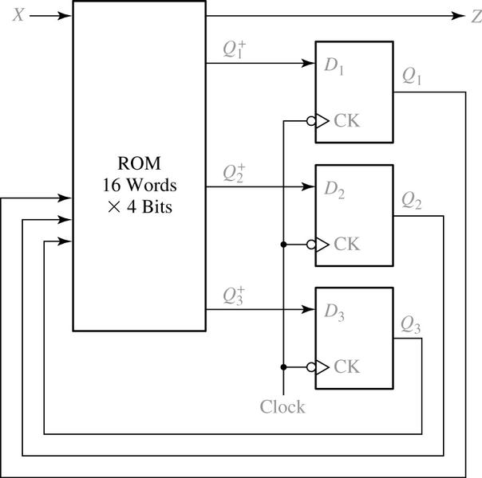
Sequential Circuit Design Using ROM
A ROM with four inputs (2⁴ words) and four outputs is required.

Slide 47
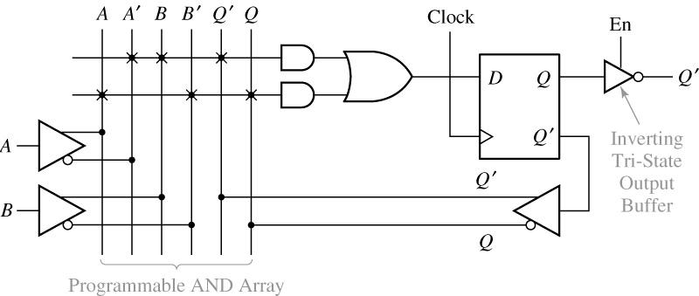
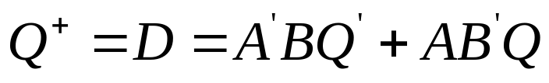
Sequential Circuit Design Using PLA
Segment of Sequential PAL

